Slide 1
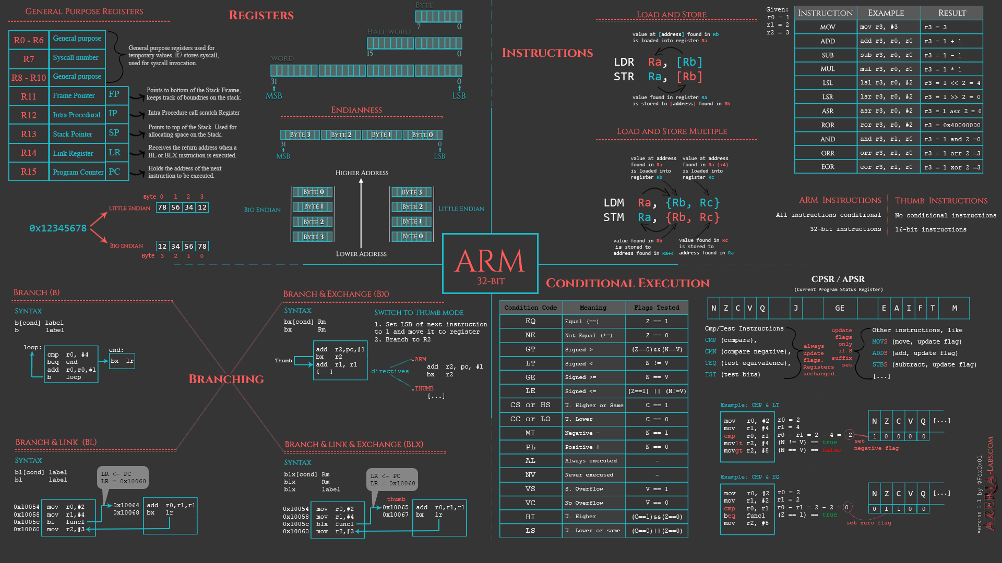
Basic i/o
8086 Assembly
CSE 315 January 2022
Md. Tareq Mahmood
Department of CSE, BUET

Slide 2

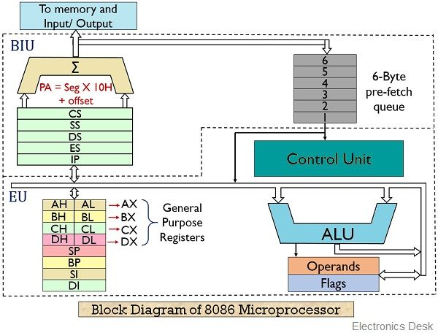
8086 Microprocessor

Slide 3
General Purpose Registers
8 general purpose registers
AX - the accumulator register (divided into AH / AL).
BX - the base address register (divided into BH / BL).
CX - the count register (divided into CH / CL).
DX - the data register (divided into DH / DL).
SI - source index register.
DI - destination index register.
BP - base pointer.
SP - stack pointer.

Slide 4
Segment Registers
4 segment registers
CS - points at the segment containing the current program.
DS - generally points at segment where variables are defined.
ES - extra segment register, it's up to a coder to define its usage.
SS - points at the segment containing the stack.

Slide 5
Special Purpose Registers
IP - the instruction pointer.
Flags Register - determines the current state of the processor.

Slide 6
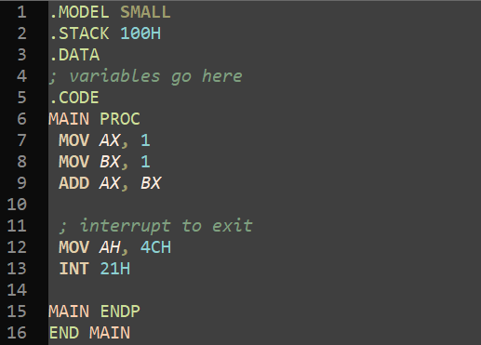
Sample Code

Slide 7
MOV Instruction
Copies the second operand (source) to the first operand (destination).
These types of operands are supported:
MOV REG, memory
MOV memory, REG
MOV REG, REG
MOV memory, immediate
MOV REG, immediate
REG:
AX, BX, CX, DX etc.
memory:
variable, etc...
immediate:
5, 3Fh, 10001101b, etc...

Slide 8
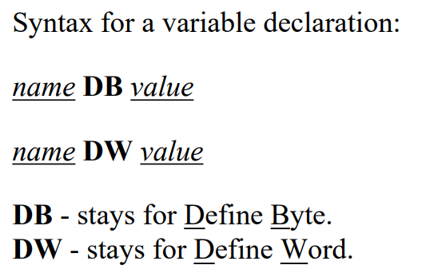
Variable Declaration

Slide 9
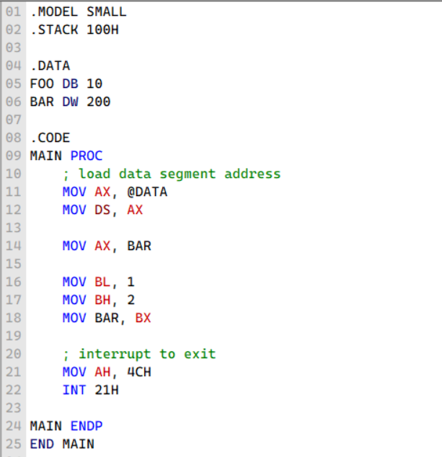
Initialize Data Segment Address
Variables will not have correct value without this

Slide 10
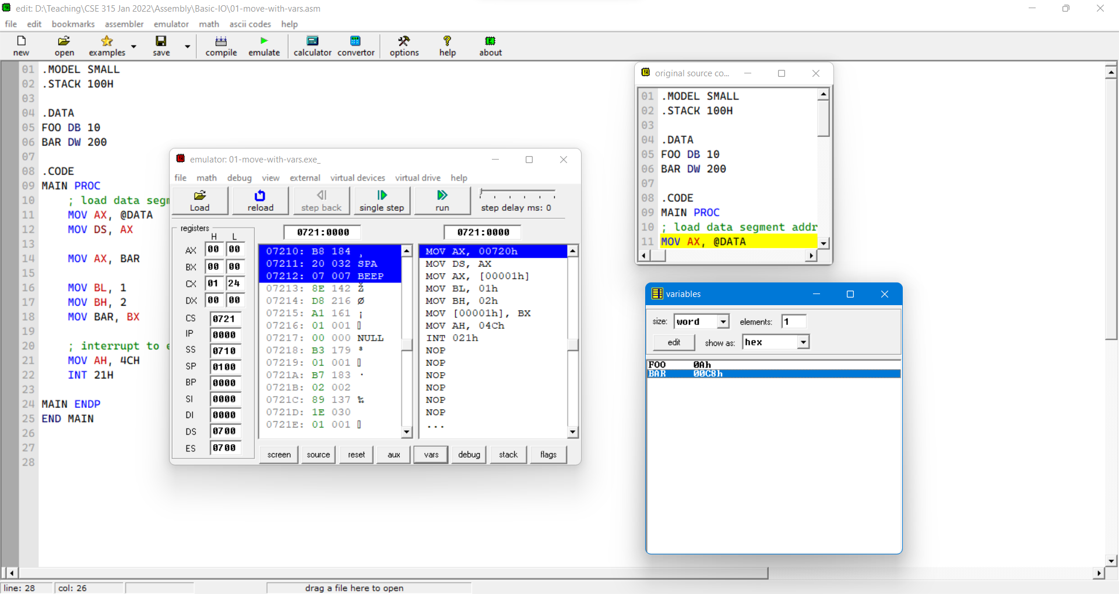
Current Instruction
Run window
Variable Inspector
Code window

Slide 11
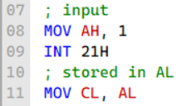
Single Byte Input
With AH = 1
INT 21H triggers input from console
Stores ASCII value in AL

Slide 12
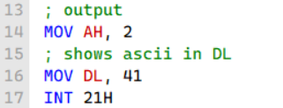
Single Byte Output
With AH = 2
INT 21H triggers output to console
Shows character with ASCII value in DL

Slide 13
What is INT 21H?
No need to fully understand now.
Come back later.
DOS can be thought of as a library used to provide a files/directories abstraction for the PC
int 21h is a simple hardware "trick" that makes it easy to call code from this library without knowing in advance where it will be located in memory.
By providing different values to the AH register, different DOS functions can be executed such as opening a file (AH=0x3D) or printing to the screen (AH=0x09).

Slide 14
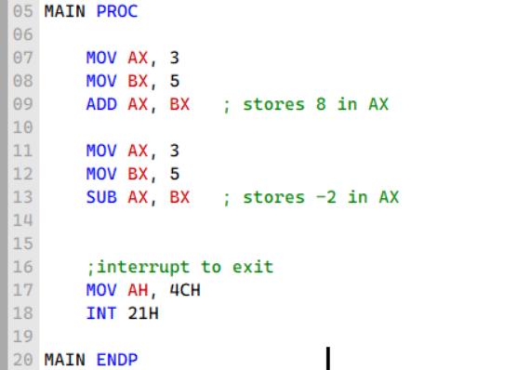
Basic Arithmetic
ADD
SUB

Slide 15
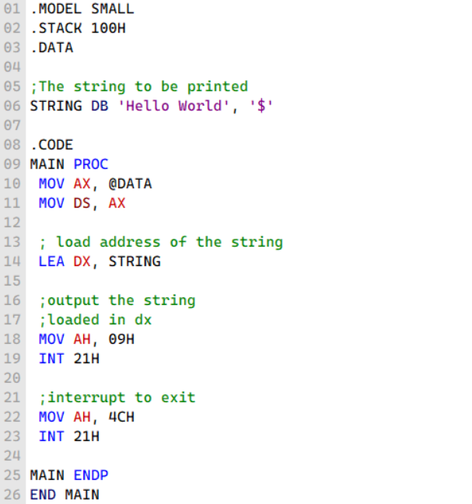
Print String
Load effective address (LEA) instruction
When AX = 09H
INT 21H triggers character printing from the address in DX
Continue to print until ‘$’ appears

Slide 16
